Slide 1
What is ORM:
ORM stands for Object-Relational Mapping is a programming technique for converting data between relational databases and object oriented programming.
No. | An ORM system has the following advantages over plain JDBC:
1 | Let’s business code access objects rather than DB tables.
2 | Hides details of SQL queries from OO logic.
3 | Based on JDBC 'under the hood.'
4 | No need to deal with the database implementation.
5 | Entities based on business concepts rather than database structure.
6 | Transaction management and automatic key generation.
7 | Fast development of application.
An ORM solution consists of the following four entities
No. | Solutions
1 | An API to perform basic CRUD operations on objects of persistent classes.
2 | A language or API to specify queries that refer to classes and properties of classes.
3 | A configurable facility for specifying mapping metadata.
4 | A technique to interact with transactional objects to perform dirty checking, lazy association fetching, and other optimization functions.
Java ORM Frameworks
There are several persistent frameworks and ORM options in Java. A persistent framework is an ORM service that stores and retrieves objects into a relational database.
Enterprise JavaBeans Entity Beans
Java Data Objects
Castor
TopLink
Spring DAO
Hibernate

Slide 2
Config:

Slide 3
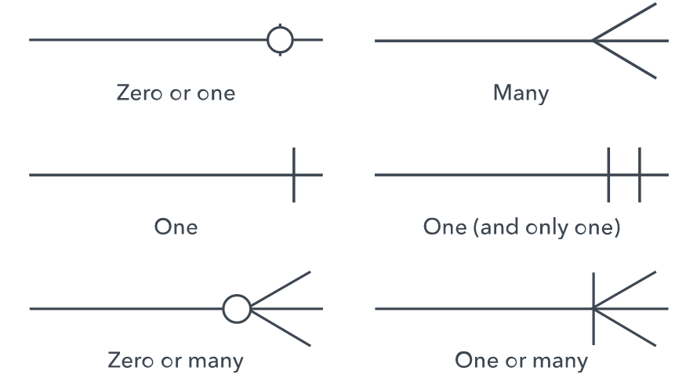
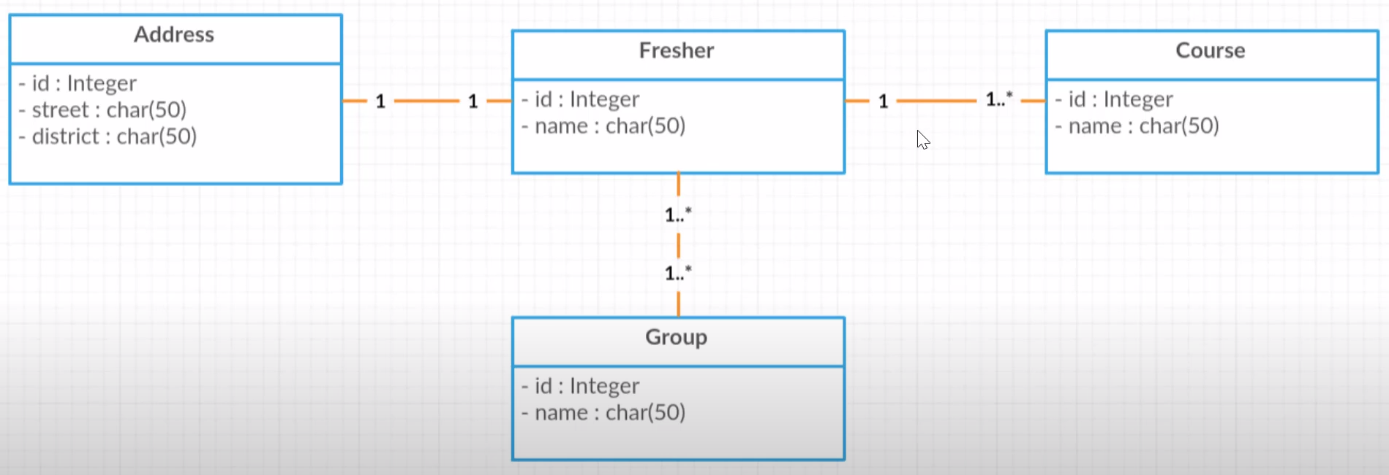
Knowledge remind:
Have three main relationship:
- 1 – 1 relationship
- 1 – n relationship
- n – n relationship
https://erdplus.com/

Slide 4
One to one:
A one-to-one relationship refers to the relationship between two entities (tables) A and B in which only one element/row of A may only be linked to one element/row of B, and vice versa.
Normally, one to one uses the foreign key to join tables
@OneToOne Annotation is used for declaring a one-to-one relationship between two entities.
It has the following parameters:
Fetch<Truy xuất> - Defines a strategy for fetching data from the database. EAGER is set to fetch by default.
<xác định chiến lược truy xuất dữ liệu từ cơ sở dữ liệu. Mặc định là EAGER >
FetchType.LAZY: data won't be initialized and loaded into a memory until an explicit call is made to it. (dữ liệu sẽ không được khởi tạo và nạp vào bộ nhớ khi chưa có một lời gọi rõ ràng ➔ cho phép saving memory và improve code performance)
FetchType.EAGER: data associating with that object will be initialized at the time and loaded into memory. (dữ liệu nào được gắn với object sẽ được khởi tạo ngay là được nạp vào memory ➔ Không cần query nhiều lần để lấy dữ liệu)
Cascade<phân cấp> - Defines a set of cascadable operations that are applied to the associated entity.
Xác định một bộ các tiến trình phân cấp được áp dụng cho các thành phần liên kiết đến 1 Entity
CascadeType.PERSIST: In this cascade operation, if the parent entity save() or persist() then all its related entity will also be save() or persist().
CascadeType.MERGE: related entities are merged when the owning entity is merged
CascadeType.REMOVE: parent entity is removed then all its related entities will also be removed
CascadeType.DETACH: parent is detached then all its related entities will also be detached.
CascadeType.REFRESH: parent entity is refreshed then all its related entities will also be refreshed.
CascadeType.ALL: above cascade operations can be applied to the entities related to the parent entity.

Slide 5
One to one:
mappedBy (in the parent entity) - Defines the entity that owns the relationship, the child entity.
orphanRemoval (in the parent entity) – delete orphaned entities from the database which is no longer attached to their parent.
optional (in the child entity) - Defines whether the relationship is optional. If set to false then a non-null relationship must always exist.
In a bidirectional relationship, we have to specify the @OneToOne annotation in both entities. But only one entity is the owner of the association. Usually, the child entity owns the relationship and the parent entity is the inverse side of the relationship.
@JoinColumn Annotation is used to specify the foreign key column in the owner of the relationship.
name: Defines the name of the foreign key column.
nullable: Defines whether the foreign key column is nullable. By default, it is true. (it also has unique, updatable,..)
referencedColumnName: defines the referenced column in the parent table.

Slide 6
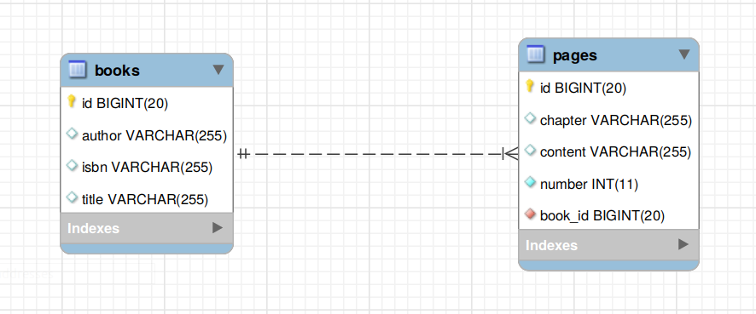
One to many & many to one:
A one-to-many relationship refers to the relationship between two entities/ tables A and B in which one element/row of A may only be linked to many elements/rows of B, but a member of B is linked to only one element/row of A.
The opposite of one-to-many is many-to-one relationship.
@OneToMany Annotation is used to define a parent in a relationship between two entities in Spring Data JPA. It has following parameters:
fetch - Defines a strategy for fetching data from the database. EAGER is set to fetch by default.
cascade - Defines a set of cascadable operations that are applied to the associated entity.
mappedBy - Defines the entity that owns the relationship which is the child entity.
orphanRemoval (in the parent entity) – delete orphaned entities from the database which is no longer attached to its parent.
@ManyToOne Annotation is used to define a child in a relationship between two entities in Spring Data JPA. It has following parameters:
fetch - Defines a strategy for fetching data from the database. EAGER is set to fetch by default.
cascade - Defines a set of cascadable operations that are applied to the associated entity.
optional – Defines the compositition of the relationship between 2 entities. Default is true.

Slide 7
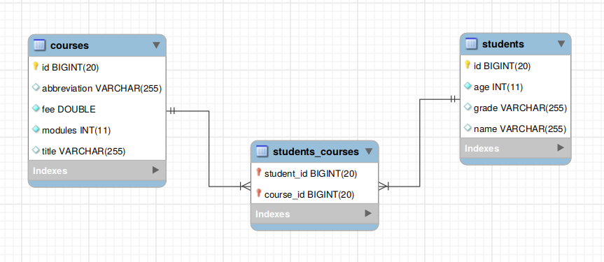
Many to Many:
A many-to-many relationship refers to the relationship between two entities/ tables A and B in which one element/row of A may only be associated with many elements/rows of B and vice versa.
To model this relationship in the database, you need to create three tables.
@ManyToMany annotation is using for declaring many-to-many relationship between two entities. It has following parameters :
fetch - Defines a strategy for fetching data from the database. EAGER is set to fetch by default
cascade - Defines a set of cascadable operations that are applied to the associated entity.
mappedBy - Defines the entity that owns the relationship which is the child entity.
@JoinTable annotation defines the join table between two entities on the owner's side of the relationship. It has following parameters:
name - The name of the join table.
joinColumns - The foreign key columns of the join table which reference the child table of the entity owning the relationship.
inverseJoinColumns – same with joinColumns but for the entity not owning the relationship.

